Slide 1

Week 0

Slide 2
Notion
Notion - https://www.notion.so/Ransomware-Network-Analysis-ff29af4a82fa48b1a1d5ecb78ac653ed?pvs=4
Github - https://github.com/TheGoofyMafia/Notes/tree/c5d925848cc59a6b8b7f90d8cad457c6934ff214/Ransomware%20Study

Slide 3
What do we have?

Slide 4
Research Papers
Your Botnet is My Botnet: Analysis of a Botnet Takeover
Ransomware detection using Deep Learning
Internet of things and ransomware
A Survey of Fast Flux Botnet Detection With Fast Flux Cloud Computing

Slide 5
Literary review format
Research ideas/question
What background support
Theoretical basis
Applicability-practical contribution
Theoretical contribution
Appropriate methodologies for carrying out the study
Appropriate statistical analyses and assumptions
Presentation of results: what do they really mean
Conclusions drawn: are they reasonable
Future work/research directions: any possibilities

Slide 6
Datasets
Elderan dataset - Dynamic analysis of 582 samples of ransomware and 942 of good applications (goodware). Contains API calls, PowerShell functions, registry edits etc.
RanSAP - Ransomware Storage Access Patterns
Timestamp [s]
Timestamp [μs]
Logical Block Address (LBA) of a read sector
Size of a block accessed by a sample [byte]
Dynamic Feature Dataset

Slide 7
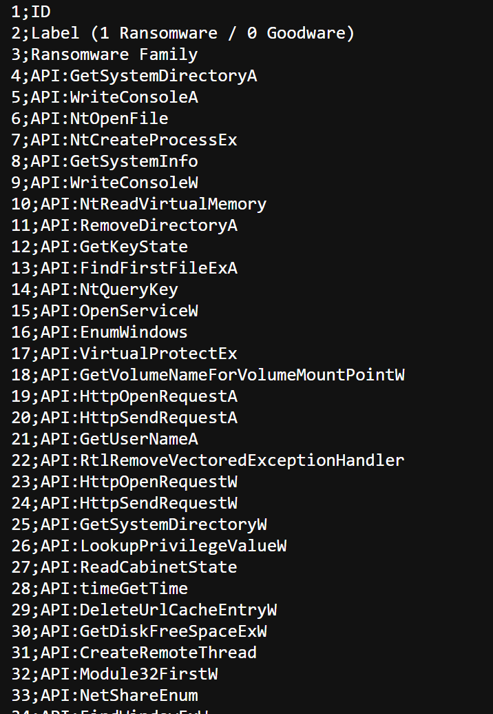
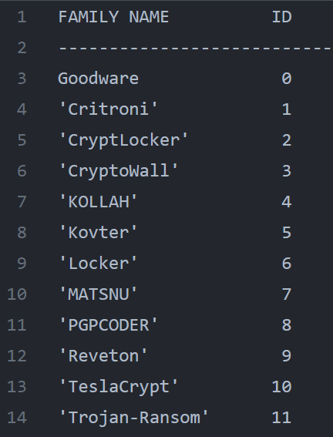
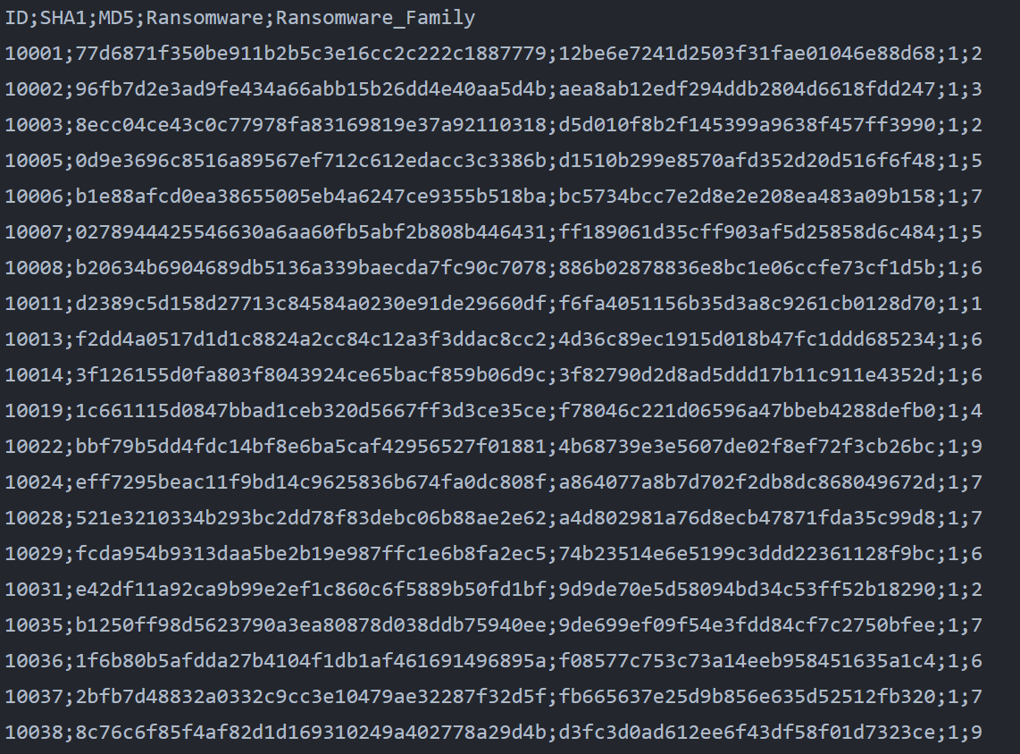
Elderan – Feature dataset from 2016

Slide 8
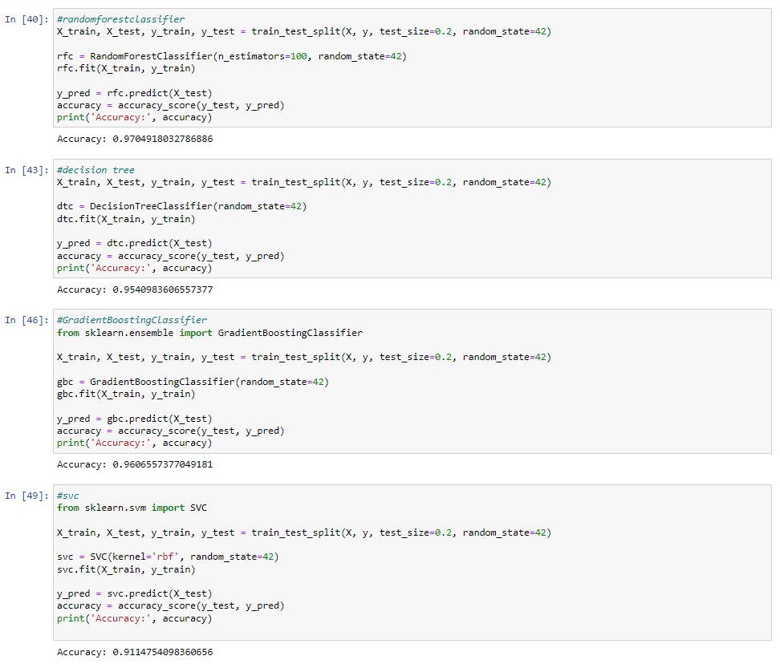

Slide 9
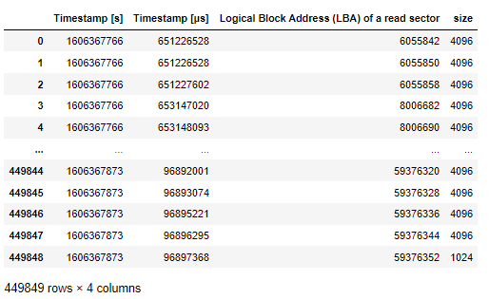
RanSAP
Timestamp [s]
Timestamp [μs]
Logical Block Address (LBA) of a read sector
Size of a block accessed by a sample [byte]

Slide 10
Week 1

Slide 11
Ransomware Detection techniques in the dawn of Artificial Intelligence: A Survey
The survey discusses multiple works involving machine learning, artificial intelligence, and deep learning to detect ransomware. The methods can be based on dynamic analysis or static analysis.
Explain in the notion page.

Slide 12
Dynamic Feature Dataset for Ransomware Detection Using Machine Learning Algorithms
Uses dynamic analysis and machine learning to identify the ever-evolving ransomware signatures using selected dynamic features. The final feature dataset is composed of 2000 registers of 50 characteristics each. This dataset allows for a machine learning detection with a 10-fold cross-evaluation with an average accuracy superior to 0.99 for gradient boosted regression trees, random forest, and neural networks.
Execute experiments with encryptor and locker ransomware combined with goodware to generate JSON files with dynamic parameters using Cuckoo sandbox.
Analyze and select the most relevant and non-redundant dynamic features for identifying encryptor and locker ransomware from goodware.
Generate and make public a dynamic features dataset that includes these selected parameters for samples of different artifacts.
Apply the dynamic feature dataset to obtain models with machine learning algorithms. Five platforms, 20 ransomware, and 20 good ware artifacts were evaluated.

Slide 13
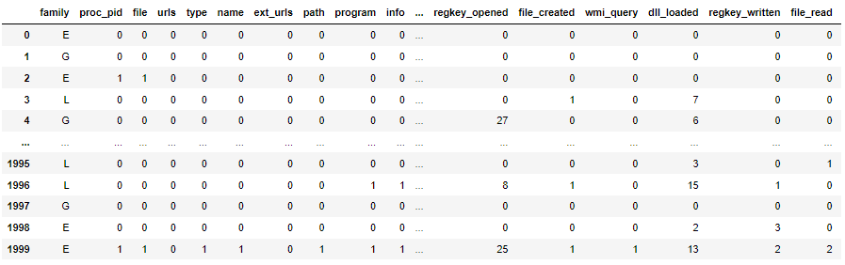
Dataset

Slide 14
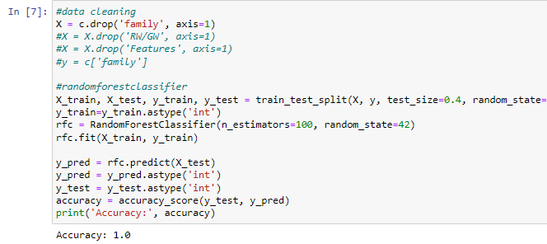

Slide 15
Cuckoo sandbox
Work in progress.
Cannot configure it correctly.

Slide 16
Week 2

Slide 17
Localizing anomalous changes in time-evolving graphs
Research Idea - The research idea presented in the passage is to address the problem of localizing anomalous changes in the structure of time-evolving, weighted graphs. The focus is on identifying abnormal changes in the relationships between nodes (edges) that lead to anomalous changes in the overall graph structure.
Method used - CAD (Commute-time based Anomaly Detection in Dynamic Graphs). CAD utilizes the concept of commute time distance, which is a measure of the expected time it takes for a random walk to travel between two nodes in a graph. The method combines information about changes in graph structure (in terms of commute time distance) and changes in edge weights to identify anomalous node relationships responsible for abnormal changes in the graph structure.

Slide 18
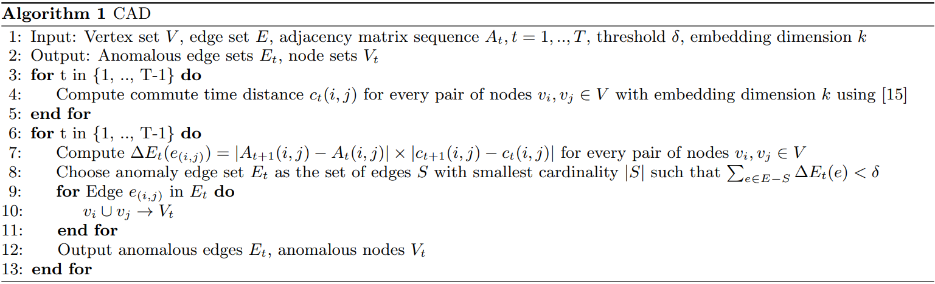
Algorithm

Slide 19
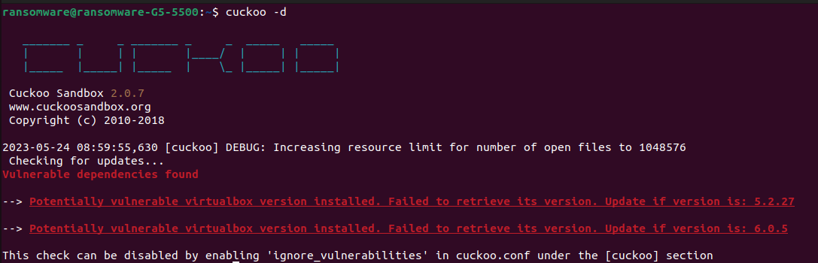
Cuckoo sandbox

Slide 20
Cuckoo sandbox
Installation completed
Host machine set up
Web server set up
Guest machines need to be set up
Network configurations need to be set up

Slide 21
Week 3

Slide 22
Cuckoo sandbox
Working except network analysis
Obtained json files for feature extraction
Obtained
Currently working for two different ransomware
Network adapter (through iptables) is not set up correctly so network analysis is not working

Slide 23
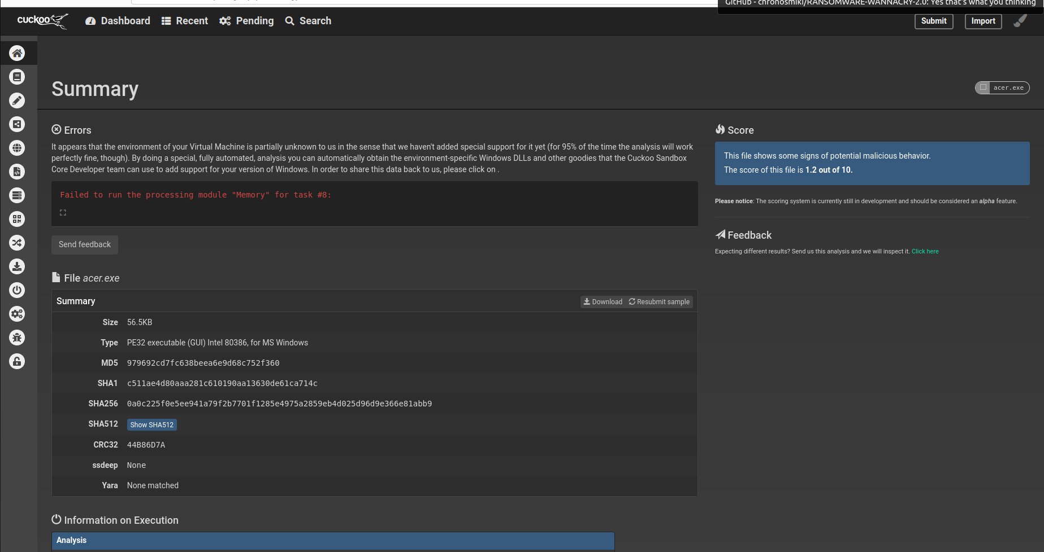
Darkside v2.1 ransomware

Slide 24
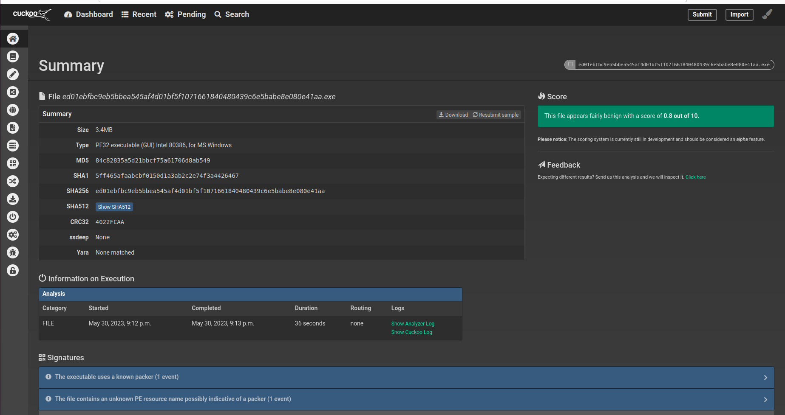
wannacry

Slide 25
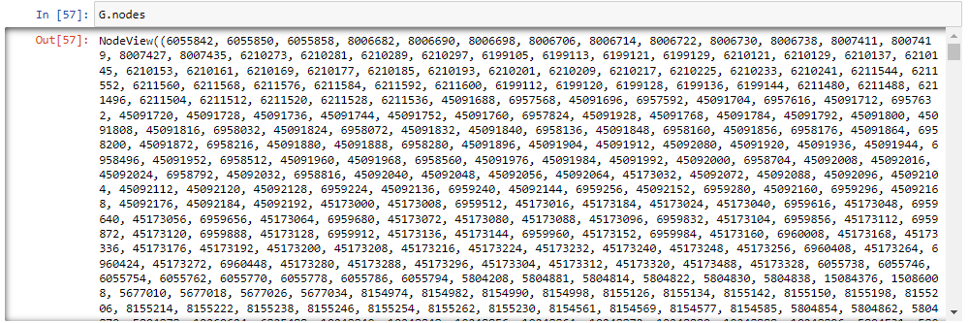
Evolving Graphs on Ransap dataset

Slide 26
Graph Learning: A Survey
In progress

Slide 27
Week 4

Slide 28
Research papers worked this week
Android Malware Detection via Graphlet Sampling
Graph Learning: A Survey

Slide 29
Graph Sampling
Pržulj et al. introduced the concept of graphlets in their study of biological networks. Graphlets are small, connected, non-isomorphic subgraphs of a given graph. While previous works focused on undirected graphs, we specifically consider directed graphlets to retain the directional information of function call graphs (FCGs).
In their work, Pržulj et al. identified 13 unique types of directed graphlets with 3 vertices (referred to as 3-graphlets). These graphlet types are not equally likely to appear in an FCG. For example, the occurrence of three mutually recursive functions (v3;13) is rare compared to other types like a function invoking two others (v3;5) or two different functions invoking the same one (v3;6). We leverage this observation to enhance the performance of our method.
For graphs with 4, 5, and 6 vertices, the number of graphlet types increases significantly, with 199, 9,364, and 1,530,843 types respectively. However, in this study, we focus on graphlets with fewer than 6 vertices since larger graphlet types require additional computations without providing significant structural information about the FCG.
Please refer to Figure 2 for an illustration of our running example, where a 4-graphlet g (represented by the grey vertices and their induced edges) is embedded within a 6-vertex graph G.

Slide 30
Things to include in the talk on friday
1 Research Paper with detailed explanation
Dynamic Feature Dataset for Ransomware Detection Using Machine Learning Algorithms
Cuckoo Sandbox
Operations
How to get it working? The procedure.
Obtained feature vectors of a Ransomware sample and a Malware sample
WannaCry and Emotet (need sample)
Brief introduction of graphs within these features and further analysis (graph samplets, methods in this paper, etc.)
Datasets obtained

Slide 31
What more can be added?
List stuff that can be added in the presentation:
Larger dataset – ransap

Slide 32
Week 5

Slide 33
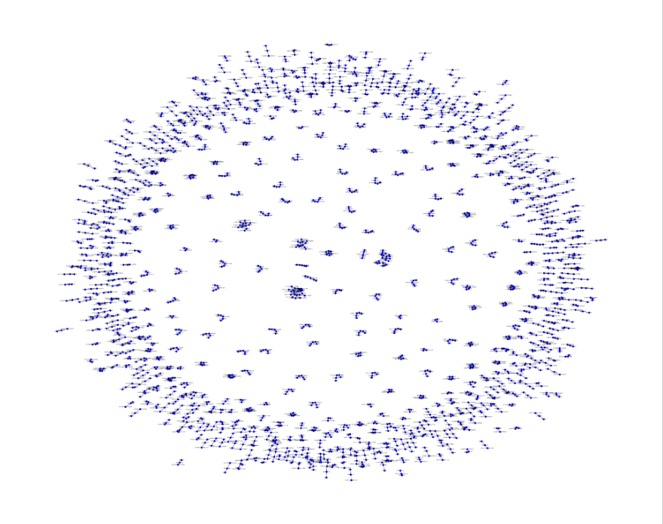
Visual representation of ransap dataset as graphs

Slide 34
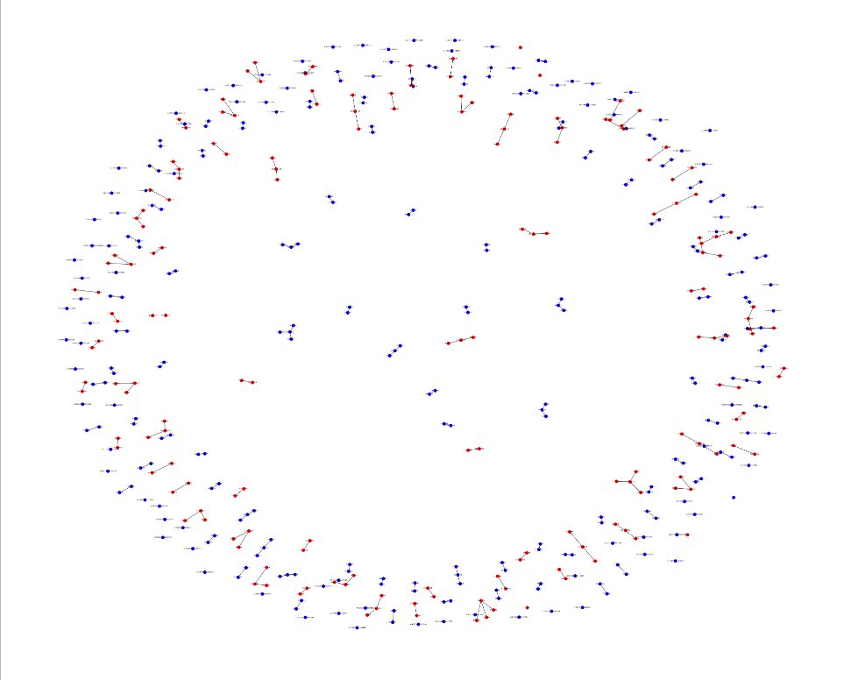
Implemented evolving graphs on the ransap dataset
Notes:
Cannot work because there are no storage access patterns datasets on goodwares

Slide 35
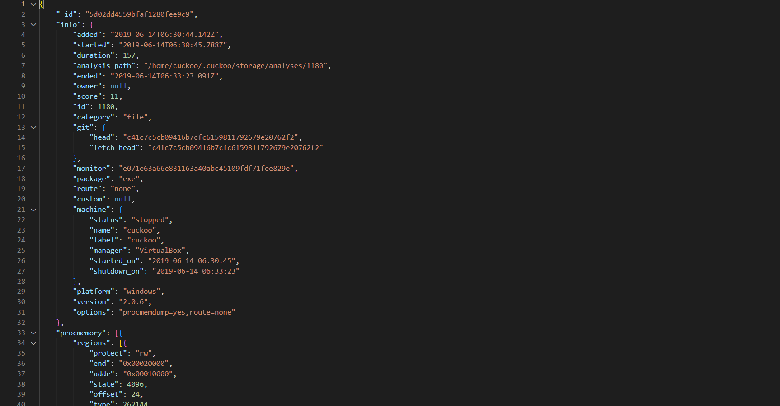
Sample json file from cuckoo sandbox

Slide 36
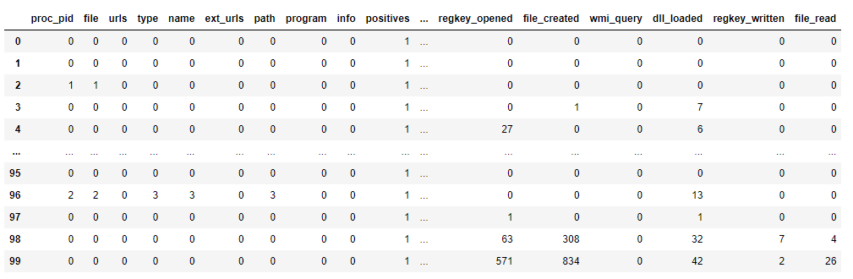
Extracting features from the json file

Slide 37
What is being done
K-Nearest Neighbouring
K-Means Clustering
Random Forest implementation

Slide 38
Week 6

Slide 39
Data prep
Extracting features from the json dataset of Cuckoo

Slide 40
Papers
Intelligent malware detection based on graph convolutional network

Slide 41
dataset
MalbehavD

